Slide 1
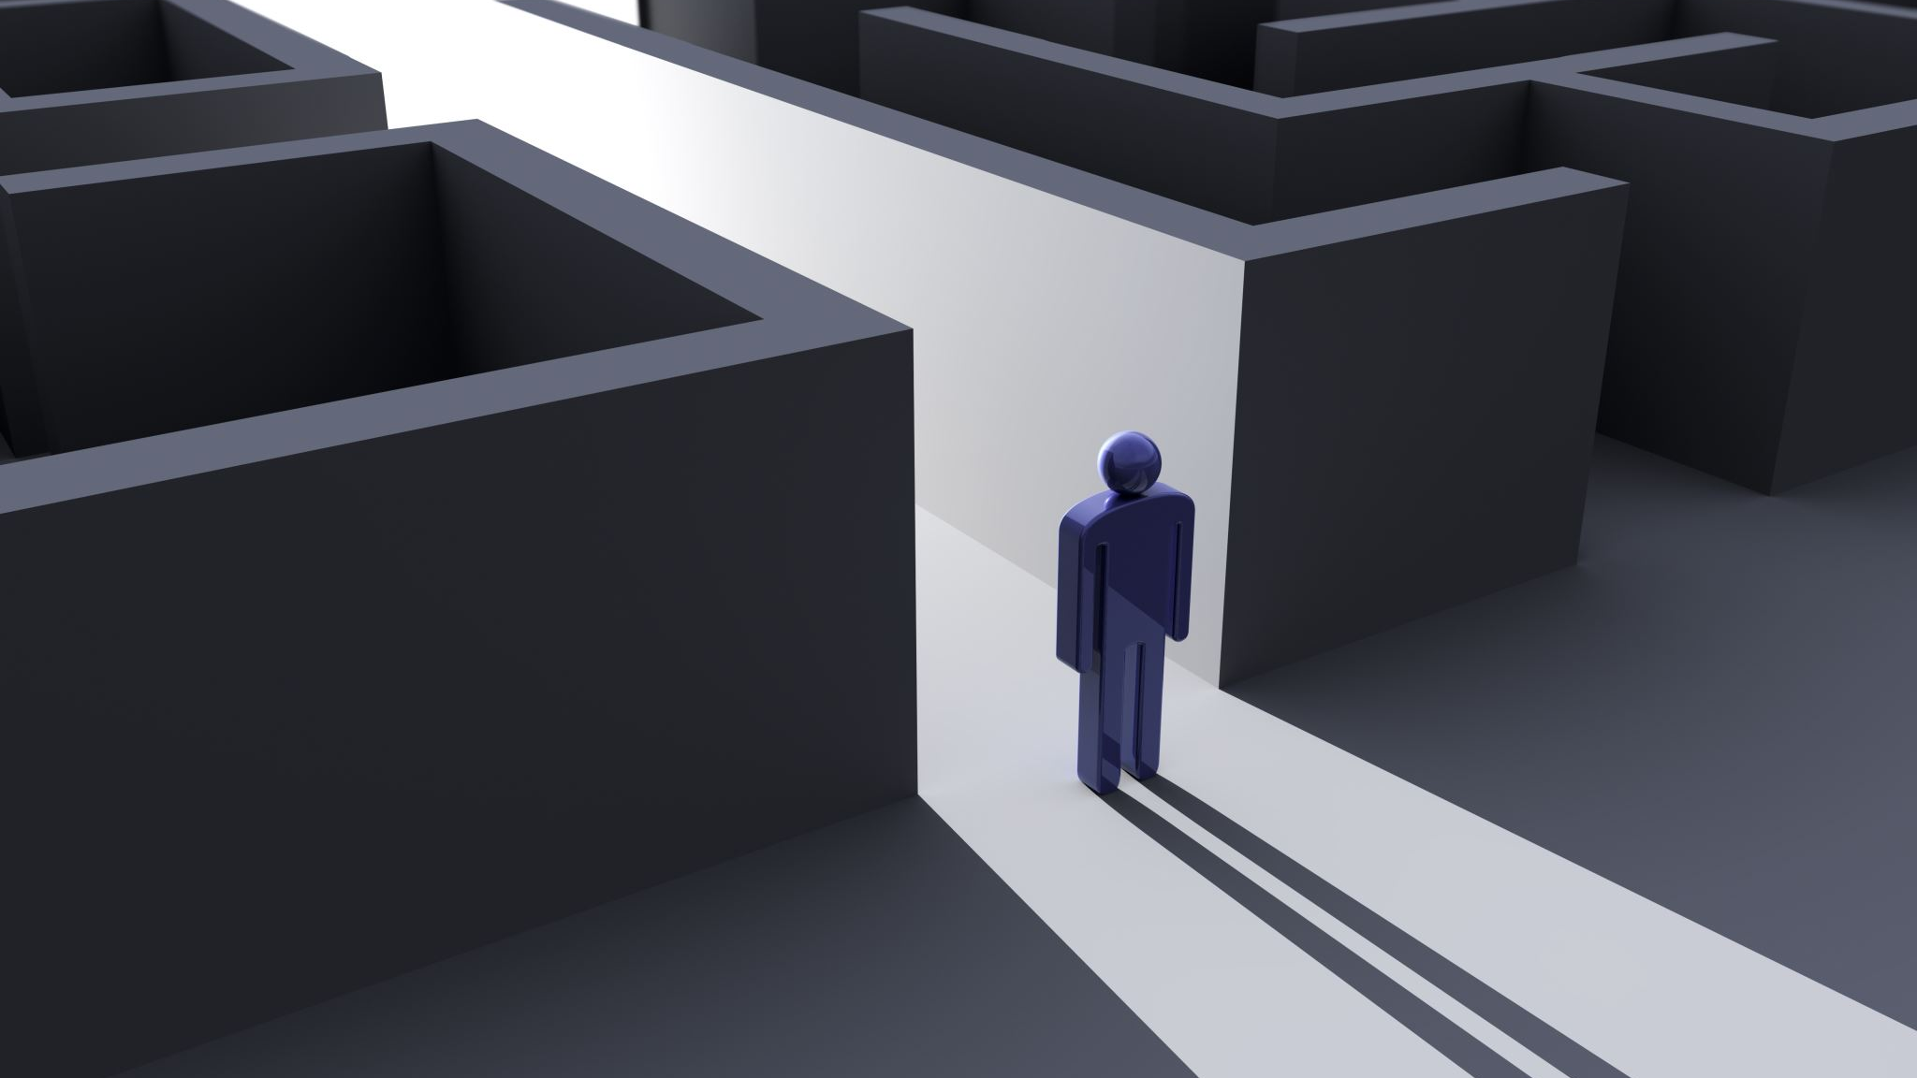
Faith:
even in pain and suffering

Slide 2
“Now faith is confidence in what we hope for, and assurance about what we do not see”.

Slide 3
Therefore, since we are surrounded by so great a cloud of witnesses, let us also lay aside every weight, and sin which clings so closely, and let us run with endurance the race that is set before us, looking to Jesus, the founder and perfecter of our faith, who for the joy that was set before him endured the cross, despising the shame, and is seated at the right hand of the throne of God. Consider him who endured from sinners such hostility against himself, so that you may not grow weary or fainthearted. In your struggle against sin you have not yet resisted to the point of shedding your blood.
Hebrews 12 1-4

Slide 4
1. What is Faith? 2. How do we develop or grow in Faith? 3. How do we keep faith during pain and suffering?

Slide 5
What is Faith: “Now faith is confidence in what we hope for, and assurance about what we do not see”.

Slide 6
How do we develop or grow in faith:

Slide 7
a process by which someone who comes to trust God begins to explore the intellectual landscape. We do not replace our faith with understanding but to supplement faith with understanding, seeing this as a natural progression from trusting God to understanding God.
Anselno of Canterburry:
“faith seeking understand”

Slide 8
Having believed in god and maid that initial decision to “become Christian” we then long to understand the inner dynamics and structure of our faith. Developing a great appreciation for what God has done throughout time, though the life death and resurrection of Jesus and also in our lives. This leads to a faith that is no longer blind but awaken, open and transformed. It’s the type of faith that affects the human mind, heart and will.
W H Griffith Thomas

Slide 9
How do we keep Faith in suffering and pain:

Slide 10
1. Patient 2. Perspective 3. Obedient 4. Centered on god 5. Joy

Slide 11
Patient “Let us run with perseverance the race marked out for us”

Slide 12
Perspective What point of view am I looking from or too? The perspective we that we have-
“surrounded by the great cloud of witnesses”

Slide 13
Obedient Therefore…..let us throw off everything that hinders and the sin that so easily entangles”

Slide 14
CS LEWIS “we are not merrily imperfect creatures who must be improved: we are rebels who must lay down our arms. We must render back our will which we have so long claimed for our own. “but to surrender a self-will inflamed and swollen with years of usurpation is a kind of death.”

Slide 15
Centered on god “Let us fix our eyes on Jesus, the author and perfector of our faith”

Slide 17
“the son of god suffered unto the death not that man might not suffer, but that their suffering might be like his.”
George Macdonald

Slide 18
Hebrews 12 Consider him who endured from sinners such hostility against himself, so that you may not grow weary or fainthearted. In your struggle against sin you have not yet resisted to the point of shedding your blood

Slide 19
Joy “who for the joy set before him endured the cross, scorning its shame and sat at the right hand of the throne of God”

Slide 20
Psalm 34:1-3 I will bless the lord at all times, his praise shall continually be in my mouth. My soul makes it’s boast in the lord, let the afflicted hear and be glad. O magnify the lord with me and let us exalt his name together.

