Slide 2
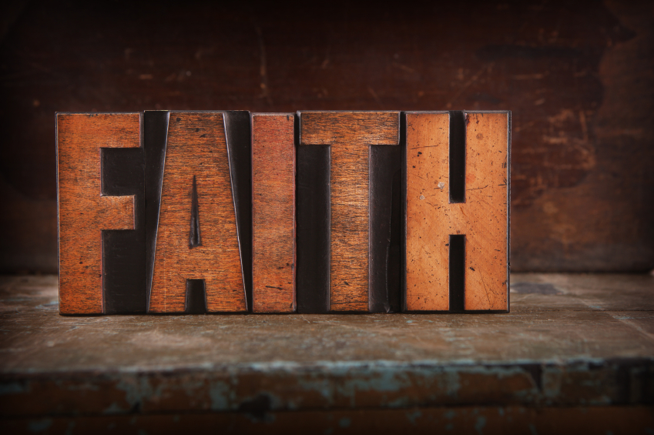
Possessing Great Faith

Slide 3
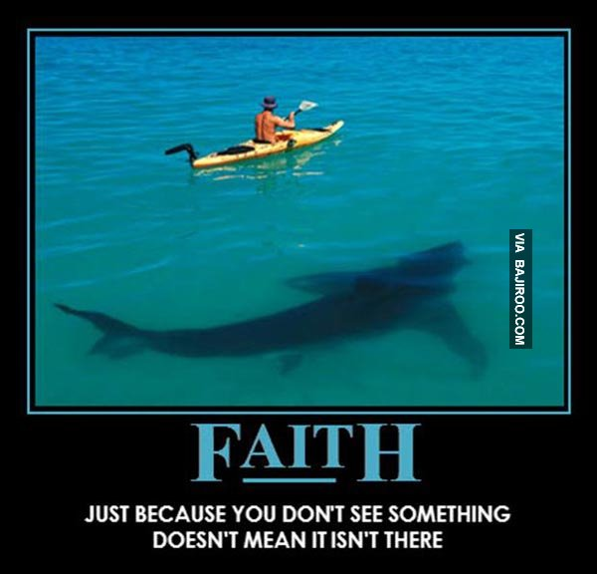

Slide 4
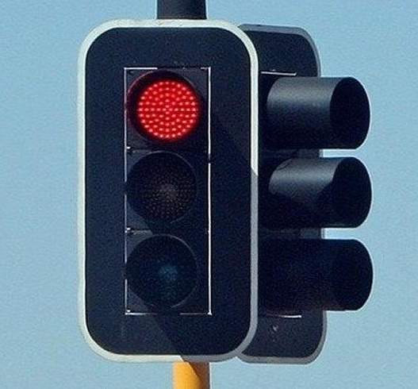
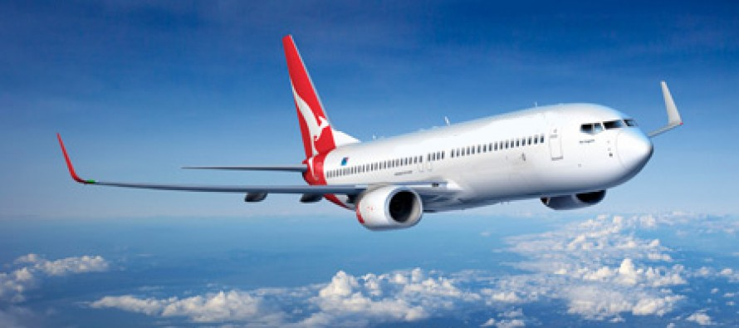

Slide 5
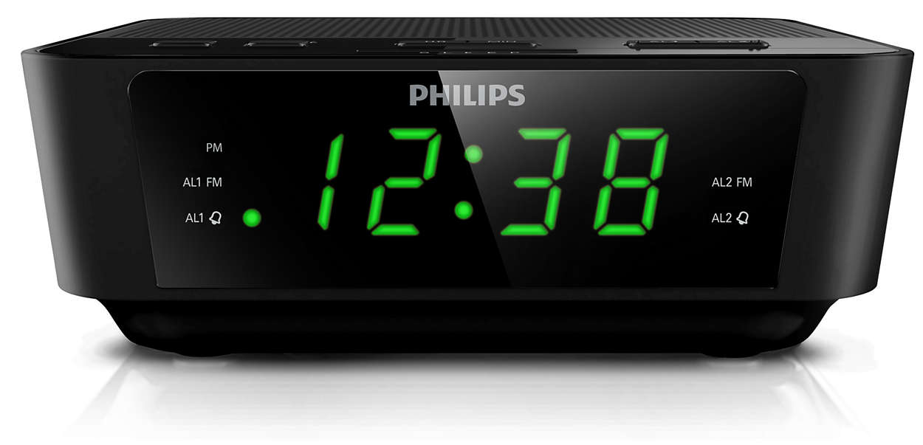

Slide 6
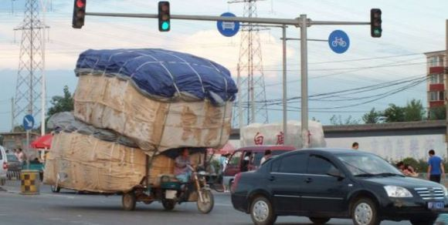

Slide 7
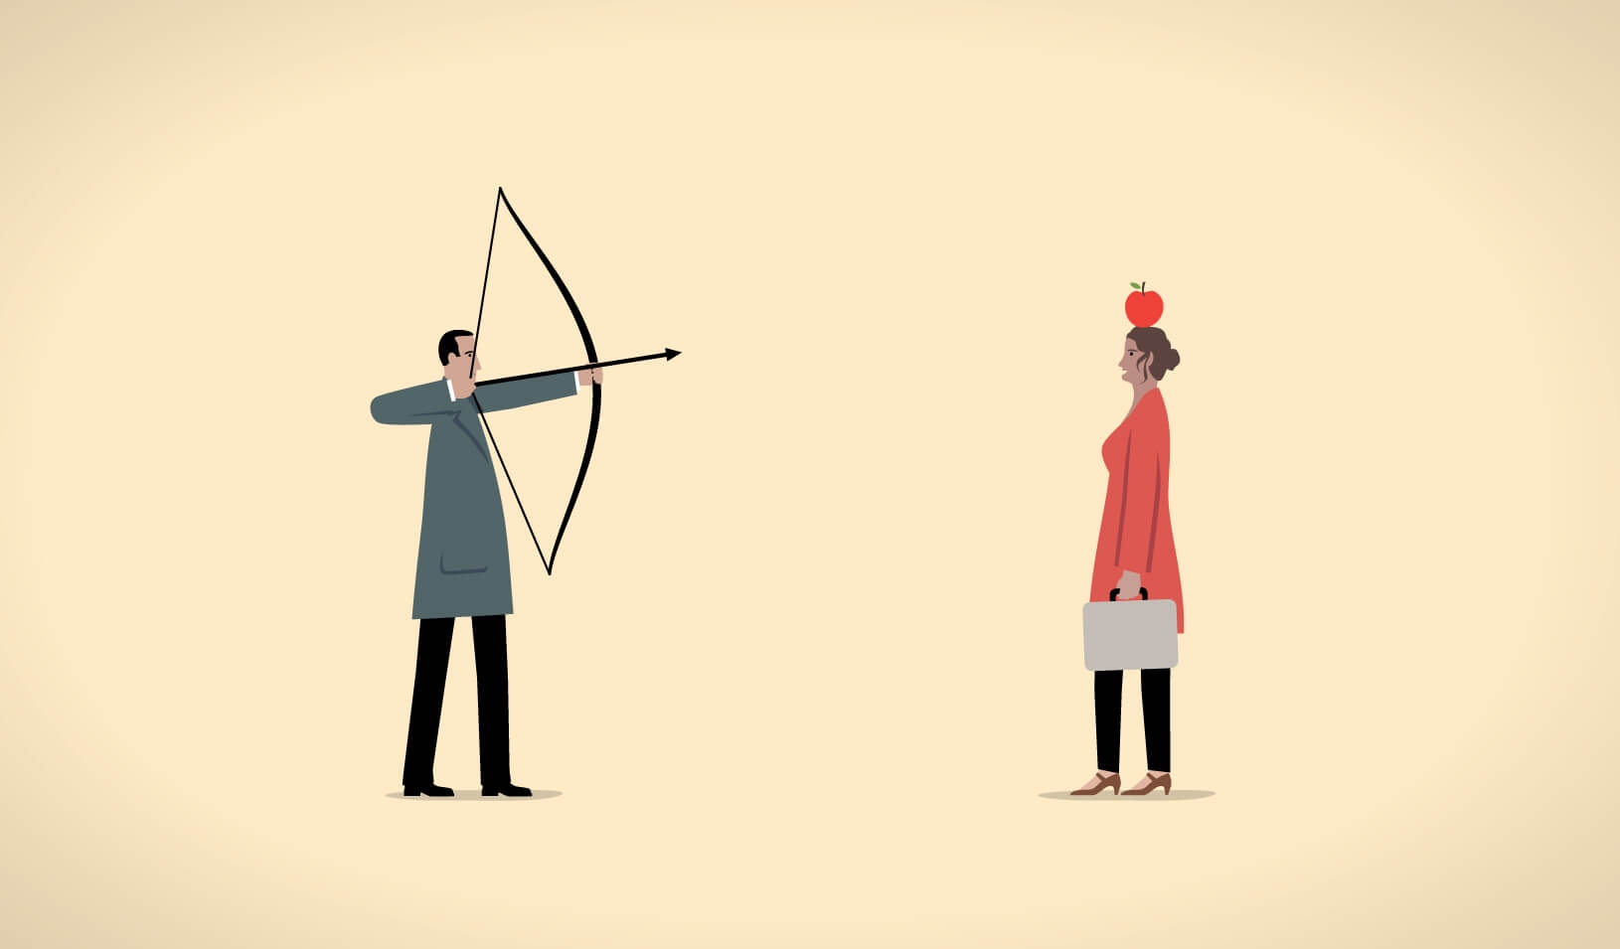

Slide 8
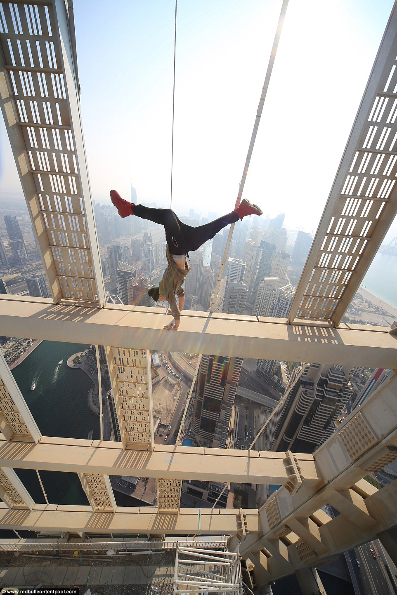

Slide 9
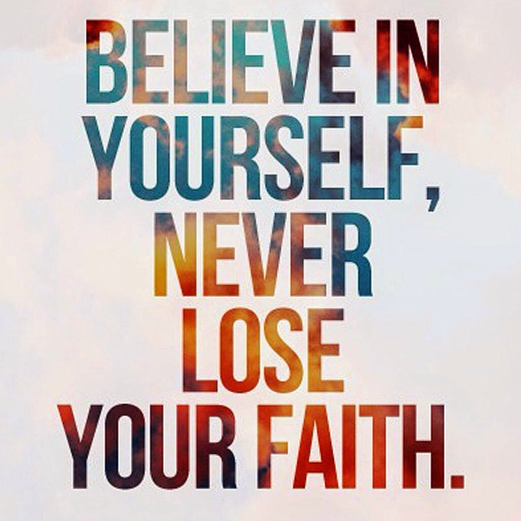

Slide 10
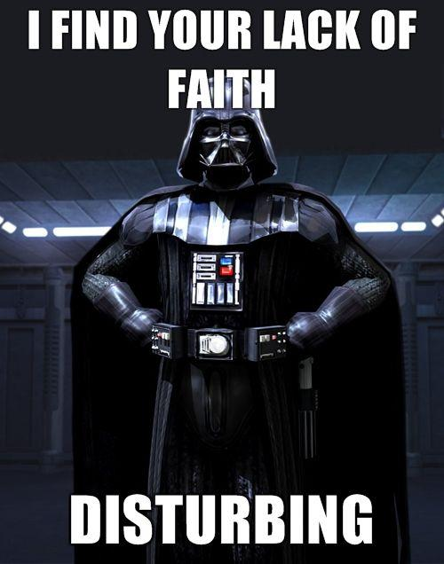

Slide 12
Luke 7:1-10
7 When Jesus had finished saying all this to the people who were listening, he entered Capernaum. ² There a centurion’s servant, whom his master valued highly, was sick and about to die. ³ The centurion heard of Jesus and sent some elders of the Jews to him, asking him to come and heal his servant.

Slide 13
⁴ When they came to Jesus, they pleaded earnestly with him, “This man deserves to have you do this, ⁵ because he loves our nation and has built our synagogue.” ⁶ So Jesus went with them.
He was not far from the house when the centurion sent friends to say to him: “Lord, don’t trouble yourself, for I do not deserve to have you come under my roof.

Slide 14
⁷ That is why I did not even consider myself worthy to come to you. But say the word, and my servant will be healed. ⁸ For I myself am a man under authority, with soldiers under me. I tell this one, ‘Go,’ and he goes; and that one, ‘Come,’ and he comes. I say to my servant, ‘Do this,’ and he does it.”

Slide 15
⁹ When Jesus heard this, he was amazed at him, and turning to the crowd following him, he said, “I tell you, I have not found such great faith even in Israel.” ¹⁰ Then the men who had been sent returned to the house and found the servant well.

Slide 16
Luke 8:40-56
⁴⁰ Now when Jesus returned, a crowd welcomed him, for they were all expecting him. ⁴¹ Then a man named Jairus, a synagogue leader, came and fell at Jesus’ feet, pleading with him to come to his house ⁴² because his only daughter, a girl of about twelve, was dying. As Jesus was on his way, the crowds almost crushed him.

Slide 17
⁴³ And a woman was there who had been subject to bleeding for twelve years, but no one could heal her. ⁴⁴ She came up behind him and touched the edge of his cloak, and immediately her bleeding stopped.
⁴⁵ “Who touched me?” Jesus asked.
When they all denied it, Peter said, “Master, the people are crowding and pressing against you.”

Slide 18
⁴⁶ But Jesus said, “Someone touched me; I know that power has gone out from me.” ⁴⁷ Then the woman, seeing that she could not go unnoticed, came trembling and fell at his feet. In the presence of all the people, she told why she had touched him and how she had been instantly healed. ⁴⁸ Then he said to her, “Daughter, your faith has healed you. Go in peace.”

Slide 19
⁴⁹ While Jesus was still speaking, someone came from the house of Jairus, the synagogue leader. “Your daughter is dead,” he said. “Don’t bother the teacher anymore.” ⁵⁰ Hearing this, Jesus said to Jairus, “Don’t be afraid; just believe, and she will be healed.”
⁵¹ When he arrived at the house of Jairus, he did not let anyone go in with him except Peter, John and James, and the child’s father and mother.

Slide 20
⁵² Meanwhile, all the people were wailing and mourning for her. “Stop wailing,” Jesus said. “She is not dead but asleep.” ⁵³ They laughed at him, knowing that she was dead. ⁵⁴ But he took her by the hand and said, “My child, get up!” ⁵⁵ Her spirit returned, and at once she stood up. Then Jesus told them to give her something to eat. ⁵⁶ Her parents were astonished, but he ordered them not to tell anyone what had happened.

Slide 21
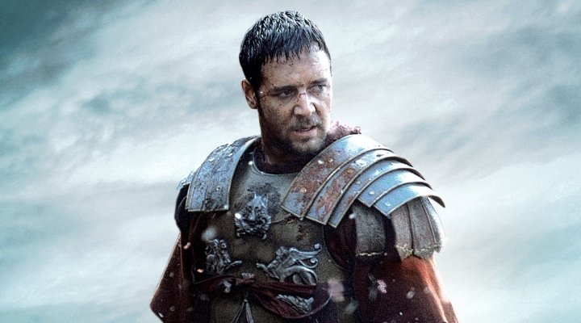
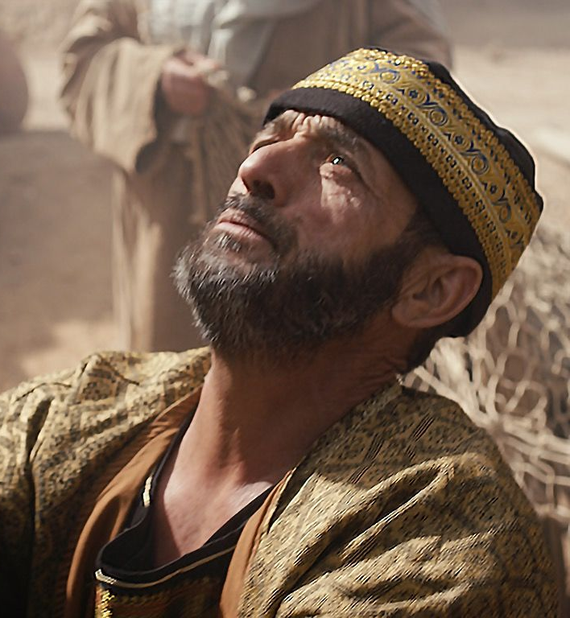
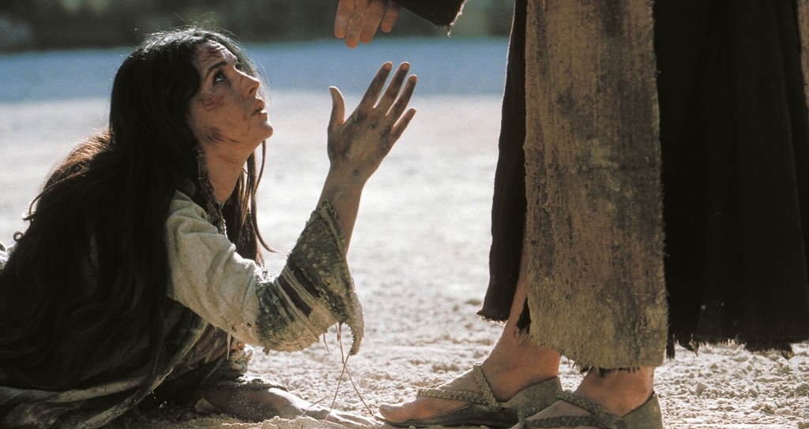

Slide 22
“Great Faith Trusts Enough To Act”

Slide 23
“I Know Him and I Believe”

Slide 24
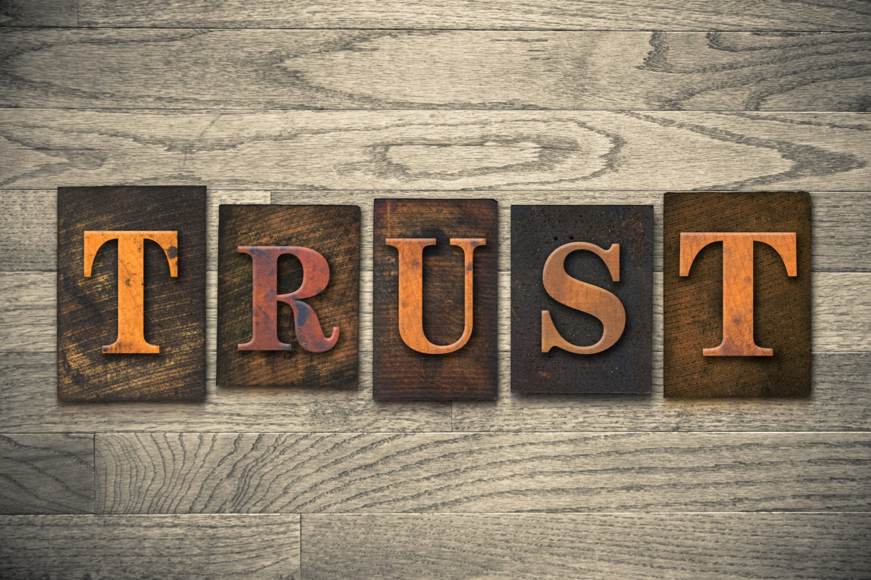
“I Believe God Can, So I Will Act”

Slide 25
Without Action Is Dead

Slide 26
James 2:14-26
¹⁴ What good is it, my brothers and sisters, if someone claims to have faith but has no deeds? Can such faith save them? ¹⁵ Suppose a brother or a sister is without clothes and daily food. ¹⁶ If one of you says to them, “Go in peace; keep warm and well fed,” but does nothing about their physical needs, what good is it? ¹⁷ In the same way, faith by itself, if it is not accompanied by action, is dead.

Slide 27
¹⁸ But someone will say, “You have faith; I have deeds.” Show me your faith without deeds, and I will show you my faith by my deeds.¹⁹ You believe that there is one God. Good! Even the demons believe that—and shudder. ²⁰ You foolish person, do you want evidence that faith without deeds is useless? ²¹ Was not our father Abraham considered righteous for what he did when he offered his son Isaac on the altar?

Slide 28
²² You see that his faith and his actions were working together, and his faith was made complete by what he did. ²³ And the scripture was fulfilled that says, “Abraham believed God, and it was credited to him as righteousness,” and he was called God’s friend. ²⁴ You see that a person is considered righteous by what they do and not by faith alone.

Slide 29
²⁵ In the same way, was not even Rahab the prostitute considered righteous for what she did when she gave lodging to the spies and sent them off in a different direction? ²⁶ As the body without the spirit is dead, so faith without deeds is dead.

Slide 30
Without Action Is Dead

Slide 32
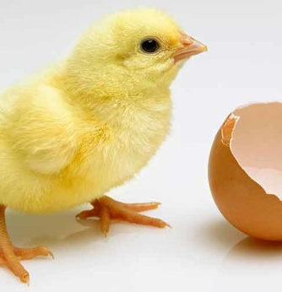
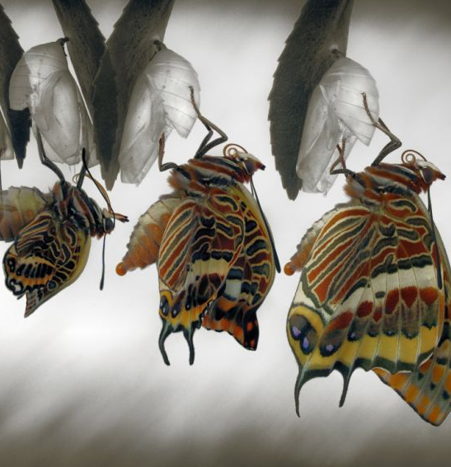

Slide 33
Stressed – Stretched – Worked – Fed

Slide 34
Do You Believe God Can…
Save? – Then go share the Gospel!
Heal? – Then go and pray for others!
Speak? – Then know His Word!
Lead? – Then ask for direction and follow!
Love? – Then put your hands to work and serve!

Slide 35
“I Believe God Can – So I Will Act”

