Slide 1
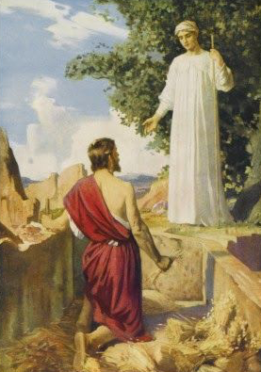
Not About Gideon
Judges 6-8

Slide 2
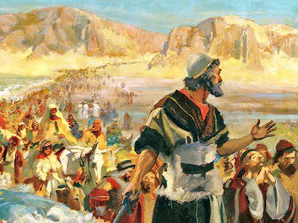

Slide 3
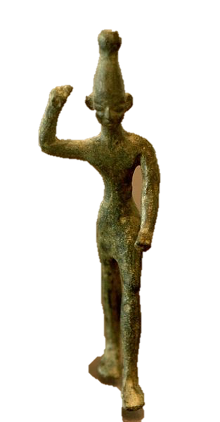
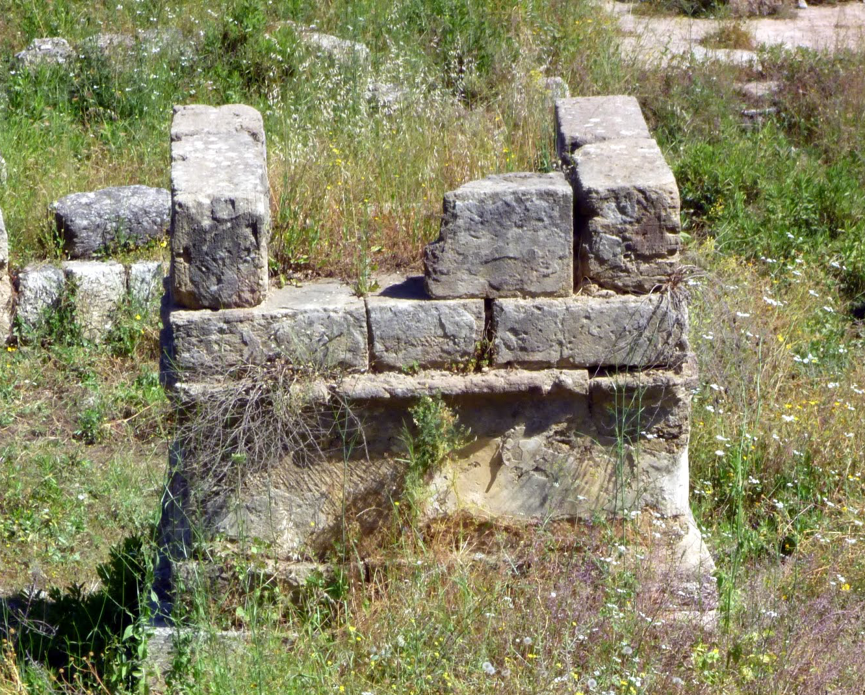
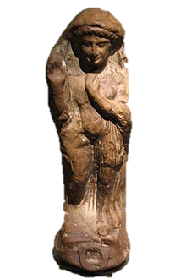
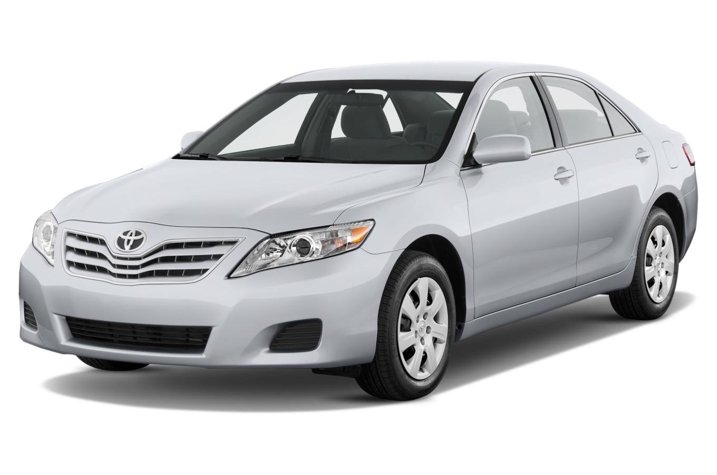

Slide 4
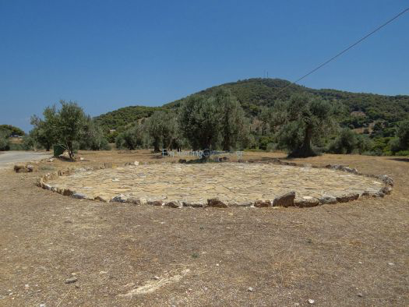
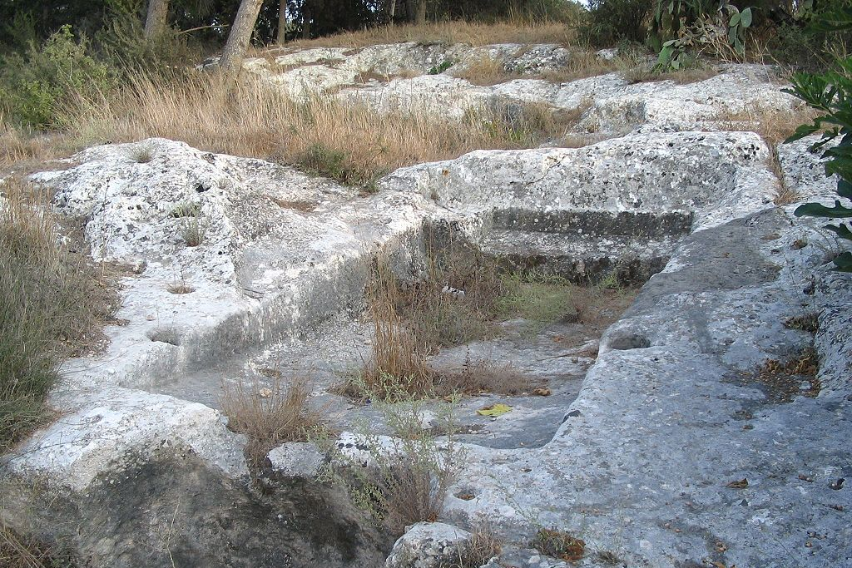

Slide 5
The Messenger of the Lord appeared to Gideon and said, “The Lord is with you, brave man.”
Judges 6:12

Slide 6
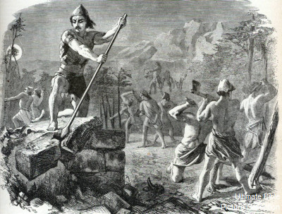

Slide 7
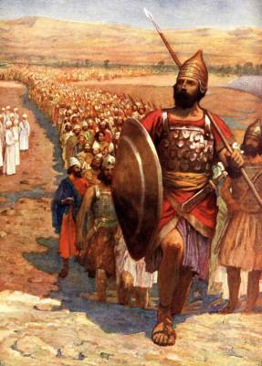

Slide 8
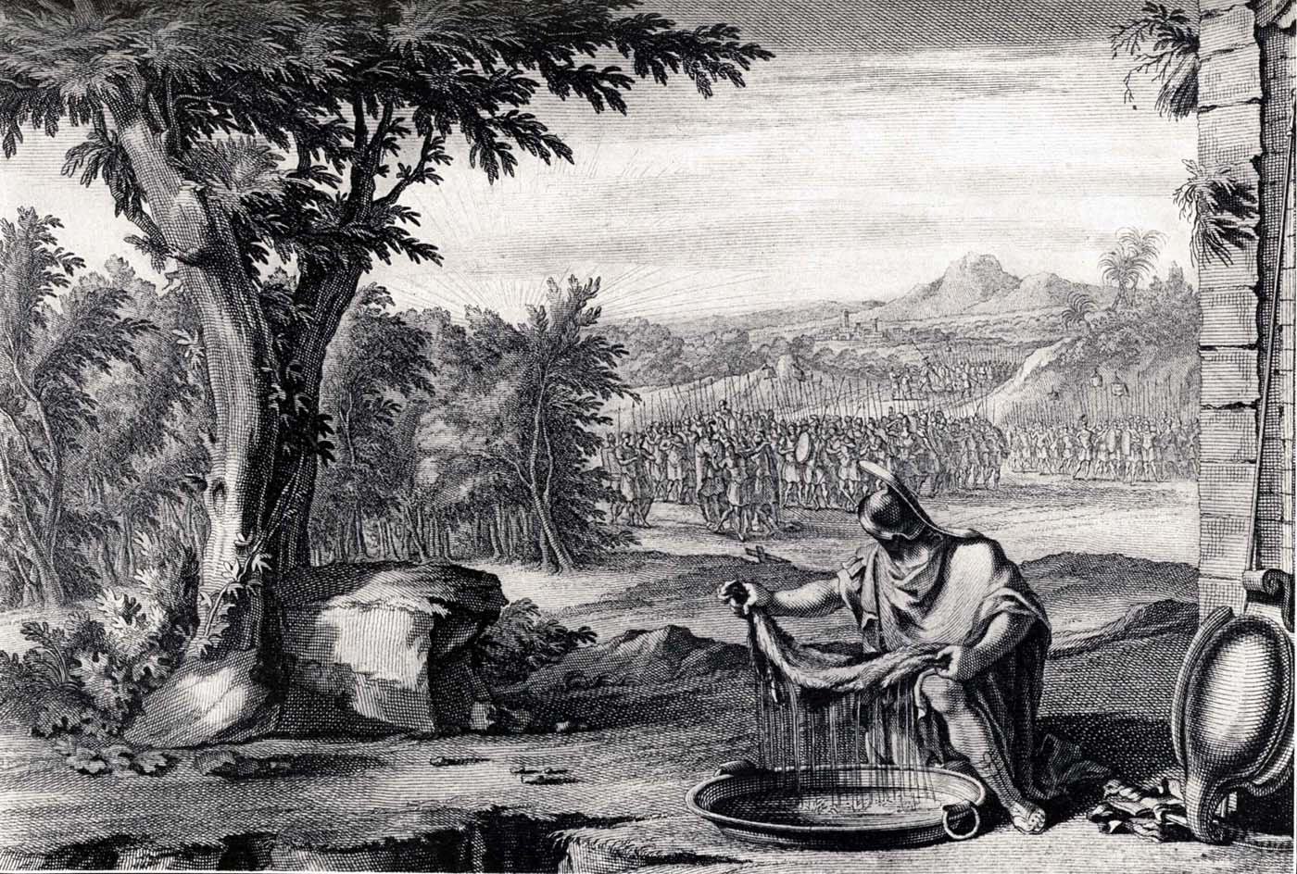

Slide 9
…You have too many men with you for me to hand Midian over to you. Israel might brag and say, ‘We saved ourselves’
Judges 7:2

Slide 10
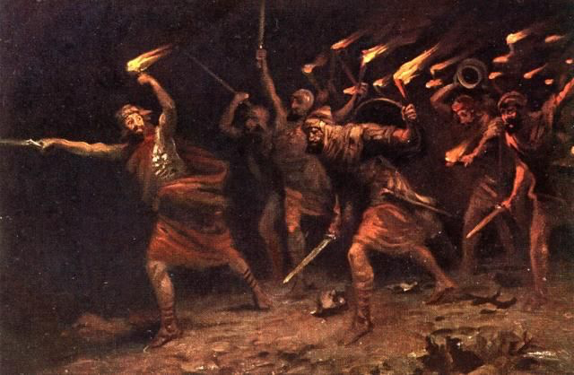

Slide 11
not Gideon
not our idols
not our might
but God

Slide 12
…You will be ever hearing but never understanding; you will be ever seeing but never perceiving.
For this people’s heart has become calloused;
they hardly hear with their ears, and they have closed their eyes.
Otherwise they might see with their eyes, hear with their ears, understand with their hearts and turn, and I would heal them.
Matthew 13:14-15

