Slide 2
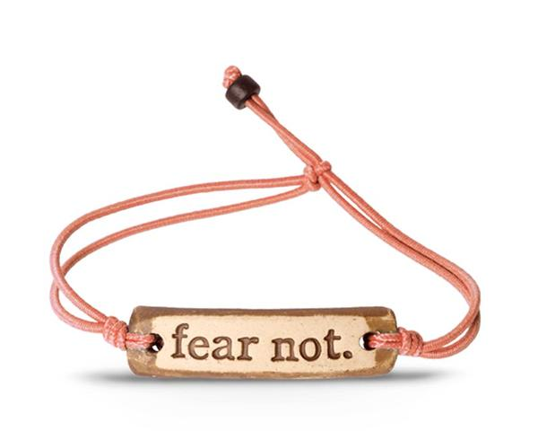
Fear is, somehow or other, the archen­emy itself. It crouches in people’s hearts. It hollows out their insides, until their resistance and strength are spent and they suddenly break down. Fear secretly gnaws and eats away at all the ties that bind a person to God and to others,

Slide 3
and when in a time of need that person reaches for those ties and clings to them, they break and the individual sinks back into himself or herself, helpless and despairing, while hell rejoices. (Bonhoeffer)

Slide 4
What role does fear play in my life?
You can never rise above your level of self-awareness

Slide 5
1 Samuel 13: 3-15
Jonathan defeated the garrison of the Philistines that was at Geba, and the Philistines heard of it. And Saul blew the trumpet throughout all the land, saying, “Let the Hebrews hear.” 4 And all Israel heard it said that Saul had defeated the garrison of the Philistines, and also that Israel had become a stench to the Philistines. And the people were called out to join Saul at Gilgal.

Slide 6
1 Samuel 13: 3-15
And the Philistines mustered to fight with Israel, thirty thousand chariots and six thousand horsemen and troops like the sand on the seashore in multitude. They came up and encamped in Michmash, to the east of Beth-aven.

Slide 7
1 Samuel 13: 3-15
When the men of Israel saw that they were in trouble (for the people were hard pressed), the people hid themselves in caves and in holes and in rocks and in tombs and in cisterns, 7 and some Hebrews crossed the fords of the Jordan to the land of Gad and Gilead.

Slide 8
1 Samuel 13: 3-15
Saul was still at Gilgal, and all the people followed him trembling. He waited seven days, the time appointed by Samuel.

Slide 9
1 Samuel 13: 3-15
But Samuel did not come to Gilgal, and the people were scattering from him. 9 So Saul said, “Bring the burnt offering here to me, and the peace offerings.” And he offered the burnt offering.

Slide 10
You can either act on fear or you can act on faith, you cannot act on both

Slide 11
1 Samuel 13: 3-15
11 “What have you done?” And Saul said, “When I saw that the people were scattering from me, and that you did not come within the days appointed, and that the Philistines had mustered at Michmash, 12 I said, ‘Now the Philistines will come down against me at Gilgal, and I have not sought the favor of the LORD.’ So I forced myself, and offered the burnt offering.”

Slide 12
1 Samuel 13: 3-15
“You have done foolishly. You have not kept the command of the LORD your God, with which he commanded you. For then the LORD would have established your kingdom over Israel forever. 14 But now your kingdom shall not continue.

Slide 13
1 Samuel 13: 3-15
The LORD has sought out a man after his own heart, and the LORD has commanded him to be prince over his people, because you have not kept what the LORD commanded you.” 15 And Samuel arose and went up from Gilgal. The rest of the people went up after Saul to meet the army; they went up from Gilgal to Gibeah of Benjamin. And Saul numbered the people who were present with him, about six hundred men.

Slide 14
Four Keys to Overcoming Fear
You have to identify it
1 Sam 9:21 – Who am I?
1 Sam 10:22 – Saul is Hiding in the baggage!

Slide 15
Four Keys to Overcoming Fear
Determine its Roots
Fear of not being accepted
Fear of losing control

Slide 16
Four Keys to Overcoming Fear
Tap into the Love of God
Acting on fear is an indicator of being out of alignment
Choose to stand on the right platform
Hold on to the truth over and over again

Slide 17
Four Keys to Overcoming Fear
Choose to Act in Faith
You cannot act on both fear and faith

