Slide 1
False Foundations
Discovering True Ways to Personal Fulfilment

Slide 2

We all search for happiness

Slide 3

But not all routes are the same

Slide 4

Living an illusion…

Slide 5
The problem with masks…
“No man, for any considerable period, can wear one face to himself and another to the multitude, without finally getting bewildered as to which may be the true.”
Nathaniel Hawthorne, The Scarlet Letter

Slide 6
The problem with masks…
“We understand how dangerous a mask can be. We all become what we pretend to be.”
Patrick Rothfuss, The Name of the Wind

Slide 7
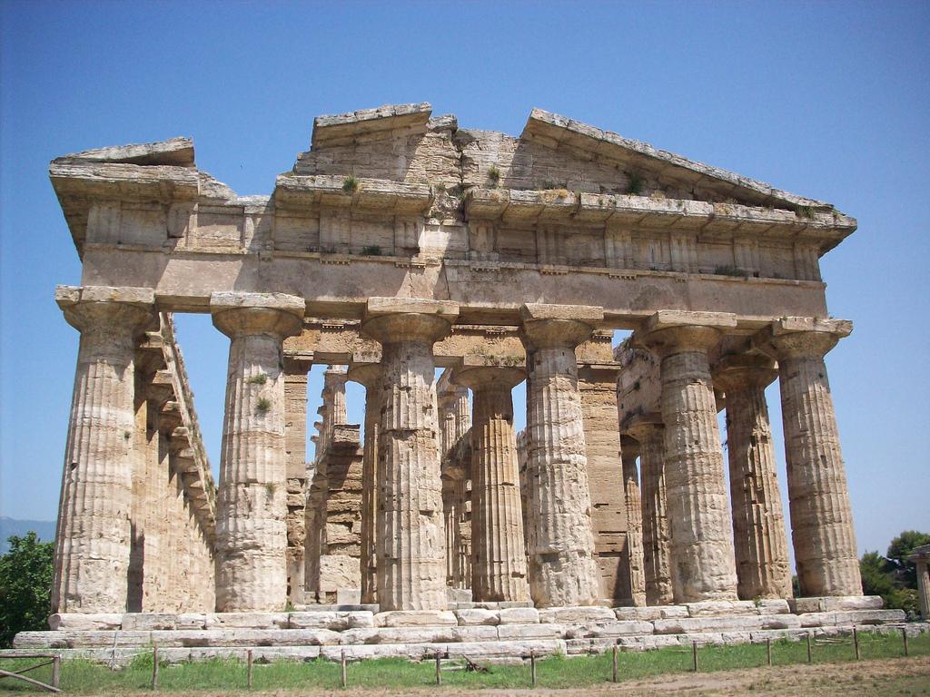
Good Foundations

Slide 8

Bad Foundations

Slide 9
Hints to False Foundations
When are you defensive?
When are you petty?
Do you have any compulsive behaviours?

Slide 10
Jesus’ Temptations
Temptation | Value is found in
Stones to Bread | Power and Control
Jump! | What People Think
Look at what you can have | Success through ‘things’

Slide 11
3 Base Lies
My value is dependent upon being in control (power)
My value is dependent upon what people think of me
My value is dependent upon my success (what I have)

Slide 12
Finding our True Self
Renew our Mind
Ground our Identity in God

Slide 13
Rom 12:2
Do not conform to the pattern of this world, but be transformed by the renewing of your mind. Then you will be able to test and approve what God’s will is—his good, pleasing and perfect will.

Slide 14
Imagine…
What does God think and feel when he thinks of you?

Slide 15
The False and True Self
The False Self | The True Self
Security and Significance achieved by what we have, what we can do and what others think of us | Security and significance achieved by being deeply loved by God
Happiness sought in apart from God | Fulfilment found in relationship with God
Identity is based on what others see | Identity is who we are and who we are becoming in Christ
Achieved by means of pretense | Received as a Gift
Maintained by effort and control | Maintained by grace

