Slide 1
Discipleship Today

Slide 2
Matt 28:16-20
¹⁶ Then the eleven disciples went to Galilee, to the mountain where Jesus had told them to go. ¹⁷ When they saw him, they worshiped him; but some doubted.¹⁸ Then Jesus came to them and said, “All authority in heaven and on earth has been given to me. ¹⁹ Therefore go and make disciples of all nations, baptising them in the name of the Father and of the Son and of the Holy Spirit, ²⁰ and teaching them to obey everything I have commanded you. And surely I am with you always, to the very end of the age.”
Notes:
I hope I’ve presented you with sound reasoning for why we need to rethink Discipleship.
We need to get back to God’s plan – back to the family and community of faith, working together to actively inform and form faith in others.
How we do it better is a whole other session which I’d love to take you through if your leaders would like that sometime in the future.
Be encouraged – it’s not all doom and gloom, God is building His church both here and around the world!
Our job is to follow His plan and Go make disciples!

Slide 3
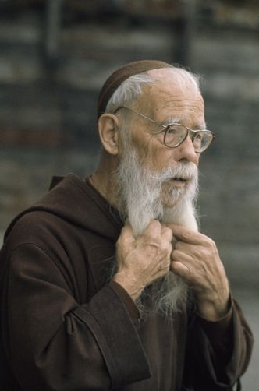
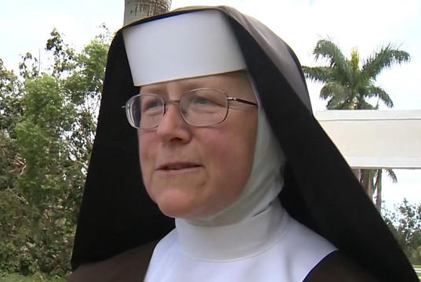
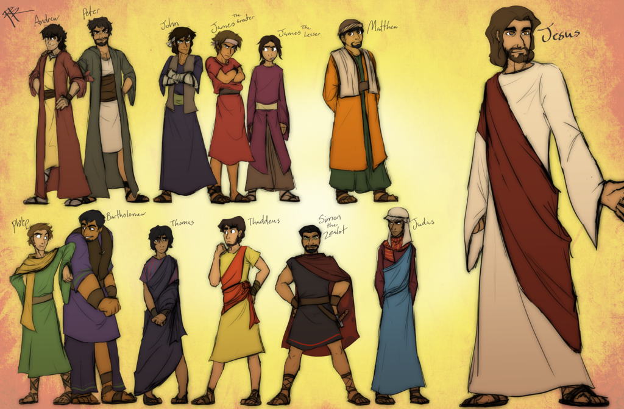
Disciple?
Notes:
I hope I’ve presented you with sound reasoning for why we need to rethink Discipleship.
We need to get back to God’s plan – back to the family and community of faith, working together to actively inform and form faith in others.
How we do it better is a whole other session which I’d love to take you through if your leaders would like that sometime in the future.
Be encouraged – it’s not all doom and gloom, God is building His church both here and around the world!
Our job is to follow His plan and Go make disciples!

Slide 4
Disciple? Me?
^{I’m a Follower of Jesus}
^{Oxford Dictionary:}
Follower: “A person who supports and admires a particular person or set of ideas”
Notes:
I hope I’ve presented you with sound reasoning for why we need to rethink Discipleship.
We need to get back to God’s plan – back to the family and community of faith, working together to actively inform and form faith in others.
How we do it better is a whole other session which I’d love to take you through if your leaders would like that sometime in the future.
Be encouraged – it’s not all doom and gloom, God is building His church both here and around the world!
Our job is to follow His plan and Go make disciples!

Slide 5
Follower?
Notes:
I hope I’ve presented you with sound reasoning for why we need to rethink Discipleship.
We need to get back to God’s plan – back to the family and community of faith, working together to actively inform and form faith in others.
How we do it better is a whole other session which I’d love to take you through if your leaders would like that sometime in the future.
Be encouraged – it’s not all doom and gloom, God is building His church both here and around the world!
Our job is to follow His plan and Go make disciples!

Slide 6
Disciple Is Different
^{Dictionary:}
“A person who is a pupil or an adherent of the doctrines of another
Notes:
I hope I’ve presented you with sound reasoning for why we need to rethink Discipleship.
We need to get back to God’s plan – back to the family and community of faith, working together to actively inform and form faith in others.
How we do it better is a whole other session which I’d love to take you through if your leaders would like that sometime in the future.
Be encouraged – it’s not all doom and gloom, God is building His church both here and around the world!
Our job is to follow His plan and Go make disciples!

Slide 7
Disciple Is Different
Follower: Supports and admires ideas
Disciple: A pupil, adheres to doctrines
Notes:
I hope I’ve presented you with sound reasoning for why we need to rethink Discipleship.
We need to get back to God’s plan – back to the family and community of faith, working together to actively inform and form faith in others.
How we do it better is a whole other session which I’d love to take you through if your leaders would like that sometime in the future.
Be encouraged – it’s not all doom and gloom, God is building His church both here and around the world!
Our job is to follow His plan and Go make disciples!

Slide 8
Called to be Disciples not Followers
Not called to support and admire Jesus and His ideas
Called to adhere to His doctrines, to be a pupil
Notes:
I hope I’ve presented you with sound reasoning for why we need to rethink Discipleship.
We need to get back to God’s plan – back to the family and community of faith, working together to actively inform and form faith in others.
How we do it better is a whole other session which I’d love to take you through if your leaders would like that sometime in the future.
Be encouraged – it’s not all doom and gloom, God is building His church both here and around the world!
Our job is to follow His plan and Go make disciples!

Slide 9
Discipleship
We associate it with formal study
To be studious, get a degree, exercise our minds, higher learning, gain knowledge
Requires great intellect, a sharp mind, a higher level of thinking
Lots of learning, not much doing
Notes:
I hope I’ve presented you with sound reasoning for why we need to rethink Discipleship.
We need to get back to God’s plan – back to the family and community of faith, working together to actively inform and form faith in others.
How we do it better is a whole other session which I’d love to take you through if your leaders would like that sometime in the future.
Be encouraged – it’s not all doom and gloom, God is building His church both here and around the world!
Our job is to follow His plan and Go make disciples!

Slide 10
Discipleship is an Apprenticeship
We’re snobby today! Apprenticeships are for those who can’t handle higher education
^{It’s seen as a lesser pursuit}
^{It’s the method used by Jesus!}
Notes:
I hope I’ve presented you with sound reasoning for why we need to rethink Discipleship.
We need to get back to God’s plan – back to the family and community of faith, working together to actively inform and form faith in others.
How we do it better is a whole other session which I’d love to take you through if your leaders would like that sometime in the future.
Be encouraged – it’s not all doom and gloom, God is building His church both here and around the world!
Our job is to follow His plan and Go make disciples!

Slide 11
Jesus was not training THEOLOGIANS, He was training PRACTICIONERS!
Notes:
I hope I’ve presented you with sound reasoning for why we need to rethink Discipleship.
We need to get back to God’s plan – back to the family and community of faith, working together to actively inform and form faith in others.
How we do it better is a whole other session which I’d love to take you through if your leaders would like that sometime in the future.
Be encouraged – it’s not all doom and gloom, God is building His church both here and around the world!
Our job is to follow His plan and Go make disciples!

Slide 12
Discipleship is an APPRENTICESHIP undertaken in an
INTENTIONAL COMMUNITY
where we learn BOTH the TEACHINGS (doctrine) of Jesus
AND the TRADE (how to do it/live it)
Notes:
I hope I’ve presented you with sound reasoning for why we need to rethink Discipleship.
We need to get back to God’s plan – back to the family and community of faith, working together to actively inform and form faith in others.
How we do it better is a whole other session which I’d love to take you through if your leaders would like that sometime in the future.
Be encouraged – it’s not all doom and gloom, God is building His church both here and around the world!
Our job is to follow His plan and Go make disciples!

Slide 13
Discipleship:
^{A Change of Direction}
It’s a change in our thinking and life trajectory
It’s a change in our lifestyle and priorities
Notes:
I hope I’ve presented you with sound reasoning for why we need to rethink Discipleship.
We need to get back to God’s plan – back to the family and community of faith, working together to actively inform and form faith in others.
How we do it better is a whole other session which I’d love to take you through if your leaders would like that sometime in the future.
Be encouraged – it’s not all doom and gloom, God is building His church both here and around the world!
Our job is to follow His plan and Go make disciples!

Slide 14
Discipleship:
^{Learning on the Move}
^{Learning through practice}
^{It’s on the job training}
Jesus’ Disciples spent 3 years learning on the go
Notes:
I hope I’ve presented you with sound reasoning for why we need to rethink Discipleship.
We need to get back to God’s plan – back to the family and community of faith, working together to actively inform and form faith in others.
How we do it better is a whole other session which I’d love to take you through if your leaders would like that sometime in the future.
Be encouraged – it’s not all doom and gloom, God is building His church both here and around the world!
Our job is to follow His plan and Go make disciples!

Slide 15
Discipleship:
Being part of an Intentional Community
^{WE instead of ME}
Greek word “ekklesia” used in the epistles means “the called out”, “the Church”
The plural of Disciple is CHURCH!
A community process not an individual one. We must ‘disciple’ TOGETHER - that’s how Jesus did it!
Notes:
I hope I’ve presented you with sound reasoning for why we need to rethink Discipleship.
We need to get back to God’s plan – back to the family and community of faith, working together to actively inform and form faith in others.
How we do it better is a whole other session which I’d love to take you through if your leaders would like that sometime in the future.
Be encouraged – it’s not all doom and gloom, God is building His church both here and around the world!
Our job is to follow His plan and Go make disciples!

Slide 16
Discipleship:
Hurts!
Notes:
I hope I’ve presented you with sound reasoning for why we need to rethink Discipleship.
We need to get back to God’s plan – back to the family and community of faith, working together to actively inform and form faith in others.
How we do it better is a whole other session which I’d love to take you through if your leaders would like that sometime in the future.
Be encouraged – it’s not all doom and gloom, God is building His church both here and around the world!
Our job is to follow His plan and Go make disciples!

Slide 17
Luke 9:23-26
²³ Then he said to them all: “Whoever wants to be my disciple must deny themselves and take up their cross daily and follow me. ²⁴ For whoever wants to save their life will lose it, but whoever loses their life for me will save it. ²⁵ What good is it for someone to gain the whole world, and yet lose or forfeit their very self? ²⁶ Whoever is ashamed of me and my words, the Son of Man will be ashamed of them when he comes in his glory and in the glory of the Father and of the holy angels.
Notes:
I hope I’ve presented you with sound reasoning for why we need to rethink Discipleship.
We need to get back to God’s plan – back to the family and community of faith, working together to actively inform and form faith in others.
How we do it better is a whole other session which I’d love to take you through if your leaders would like that sometime in the future.
Be encouraged – it’s not all doom and gloom, God is building His church both here and around the world!
Our job is to follow His plan and Go make disciples!

Slide 18
Discipleship:
^{Hurts}
^{Requires sacrifice}
Requires denying our own wants and desires to put God first
Requires hard work, time, patience and failure
Notes:
I hope I’ve presented you with sound reasoning for why we need to rethink Discipleship.
We need to get back to God’s plan – back to the family and community of faith, working together to actively inform and form faith in others.
How we do it better is a whole other session which I’d love to take you through if your leaders would like that sometime in the future.
Be encouraged – it’s not all doom and gloom, God is building His church both here and around the world!
Our job is to follow His plan and Go make disciples!

Slide 19
Discipleship:
Requires Dependence on the Holy Spirit
The Holy Spirit changes the heart and imparts teaching, wisdom and understanding (John 14:15-27)
Brings power to resist temptation (James 4:7)
^{Renews our mind (Rom 12:2)}
Empowers us to be Holy (1 Peter 1:13-15)
Notes:
I hope I’ve presented you with sound reasoning for why we need to rethink Discipleship.
We need to get back to God’s plan – back to the family and community of faith, working together to actively inform and form faith in others.
How we do it better is a whole other session which I’d love to take you through if your leaders would like that sometime in the future.
Be encouraged – it’s not all doom and gloom, God is building His church both here and around the world!
Our job is to follow His plan and Go make disciples!

Slide 20
Who Is Writing the Story of Your Life?
Who Is Feeding Your Soul, Educating Your Mind and
Training Your Thoughts?
Notes:
I hope I’ve presented you with sound reasoning for why we need to rethink Discipleship.
We need to get back to God’s plan – back to the family and community of faith, working together to actively inform and form faith in others.
How we do it better is a whole other session which I’d love to take you through if your leaders would like that sometime in the future.
Be encouraged – it’s not all doom and gloom, God is building His church both here and around the world!
Our job is to follow His plan and Go make disciples!

