Slide 1
Which Story?
Jason Wong
Rolf Van Wollingen
Canberra Chinese Christian Church Camp 2018

Slide 2
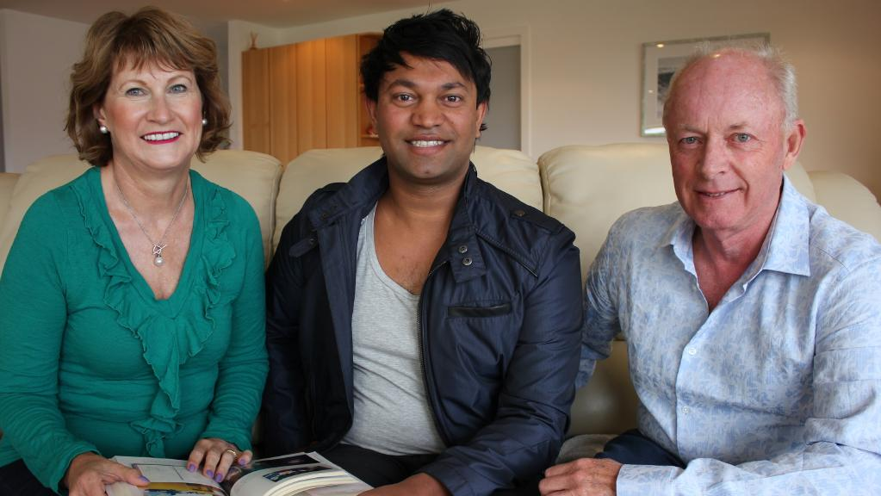
Which Story?
(i) Lion: The true story of a life lost and found
Saroo with his adoptive parents, Sue & John Brierley

Slide 3
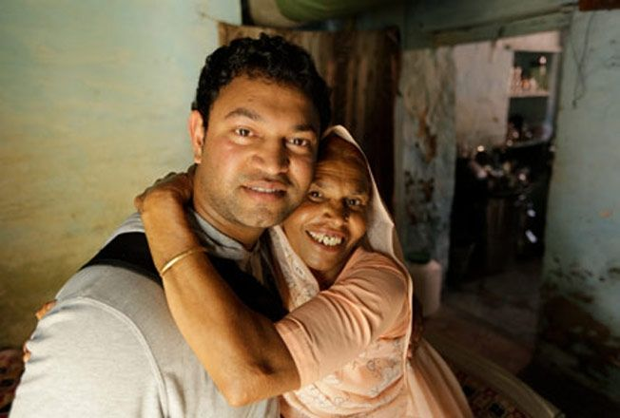
Which Story?
(i) Lion: The true story of a life lost and found
Saroo with his birth mother, Kamla Munshi

Slide 4
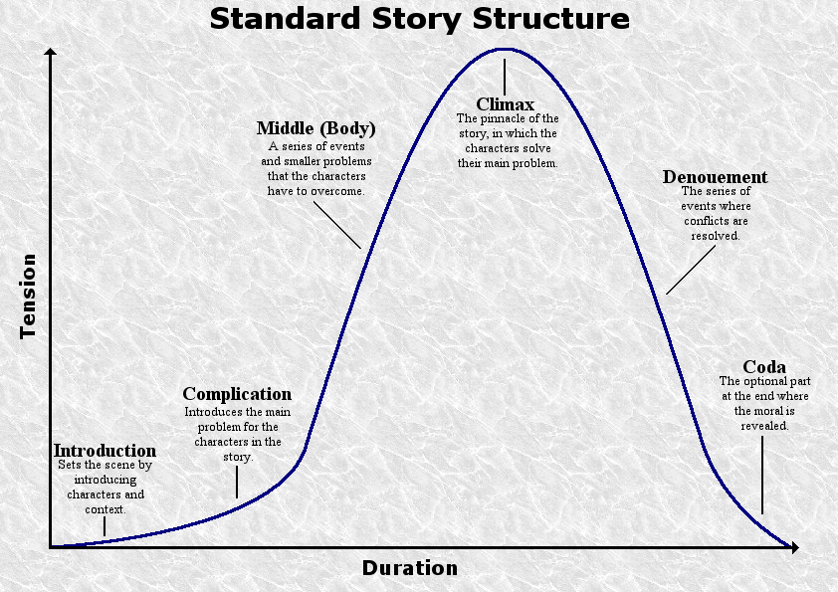
Which Story?
(ii) The Story of your Life
Act 1
Act 2
Act 3

Slide 5
Which Story?
(ii) The Story of your Life
“³⁹ You study the Scriptures diligently because you think that in them you have eternal life. These are the very Scriptures that testify about me, ⁴⁰ yet you refuse to come to me to have life. … ⁴⁵ But do not think I will accuse you before the Father. Your accuser is Moses, on whom your hopes are set. ⁴⁶ If you believed Moses, you would believe me, for he wrote about me. ⁴⁷ But since you do not believe what he wrote, how are you going to believe what I say?” (John 5:39-47 NIV)

Slide 6
Which Story?
(iii) Discuss in pairs
Q. Briefly share in outline the story of your life. What narratives have influenced and shaped your life story?

Slide 7
Which Story?
(iv) The Narrative Substructure of Romans
“I will raise up your offspring to succeed you, your own flesh and blood, and I will establish his kingdom. … ¹⁶ Your house and your kingdom will endure forever before me; your throne will be established forever.”
(2 Samuel 7:12-16)

Slide 8
Which Story?
(iv) The Narrative Substructure of Romans
God’s Great Plan of Salvation:
The Day of Judgement
Creation
New Creation
The Fall
Jesus’death resurrection & ascension
We are here
Jesus’ birth
Jesus’
Return
Adam
The Resurrection
Abraham
Moses
David
2091 BC
1406 BC
1025 BC
2018 AD
“the present age”
“the age to come”

Slide 9
Which Story?
(v) Small Group Discussion
Q. Think about the story of your life. Share how the story of your life intersected and now overlaps with the Story of God’s GPS – God’s Great Plan of Salvation?
In about 15 minutes we’ll come back together again and share what we’ve found. Please appoint a scribe to make notes of your findings.

Slide 10
Which Story?
(vi) Large Group Sharing

Slide 11
Which Story?
(vii) Summing Up

Slide 12
Which Story?
(viii) Personal Reflection
Recall how you came to faith in Jesus Christ as your Saviour and Lord. Spend some time thanking God for adopting you as his child, including you in Christ, and incorporating you into his GPS – his Great Plan of Salvation.
Reflect on your own life story. Can you see how God has been making all things work together for good, to bring to completion his great purpose of transforming your life more and more into the image of his Son – Jesus? Talk to God about any aspects of your life that you wish were different. Ask him to show you how even those things can be used by him for good.

