Slide 1
Your Circle of Influence

Slide 2
Define ‘Circle of Influence’
people you know whom you may receive assistance from or give assistance too.
the more people you get to know, the larger your circle of influence becomes

Slide 3
Define ‘Circle of Influence’
a meaningful interaction that we have with another person, either directly or indirectly.

Slide 4
Quantify ‘Circle of Influence’
Person in Australia living in a city
3 meaningful interactions a day
Average lifespan is 82.10 years
Begin at the age of 5
365 days a year (forget leap years)

Slide 5
Quantify ‘Circle of Influence’
Our equation looks like:
(82.10 – 5) x 3 x 365 = 84,442.5

Slide 6
Quantify ‘Circle of Influence’
Very conservative 84,500 direct meaningful interactions
Over 250,000 direct and indirect influential interactions over our lifetime.

Slide 7
Who Is Watching You?

Slide 8
¹³ “You are the salt of the earth, but if salt has lost its taste, how shall its saltiness be restored? It is no longer good for anything except to be thrown out and trampled under people's feet.
Matthew 5:13-16

Slide 9
¹⁴ “You are the light of the world. A city set on a hill cannot be hidden. ¹⁵ Nor do people light a lamp and put it under a basket, but on a stand, and it gives light to all in the house.

Slide 10
¹⁶ In the same way, let your light shine before others, so that they may see your good works and give glory to your Father who is in heaven.

Slide 11
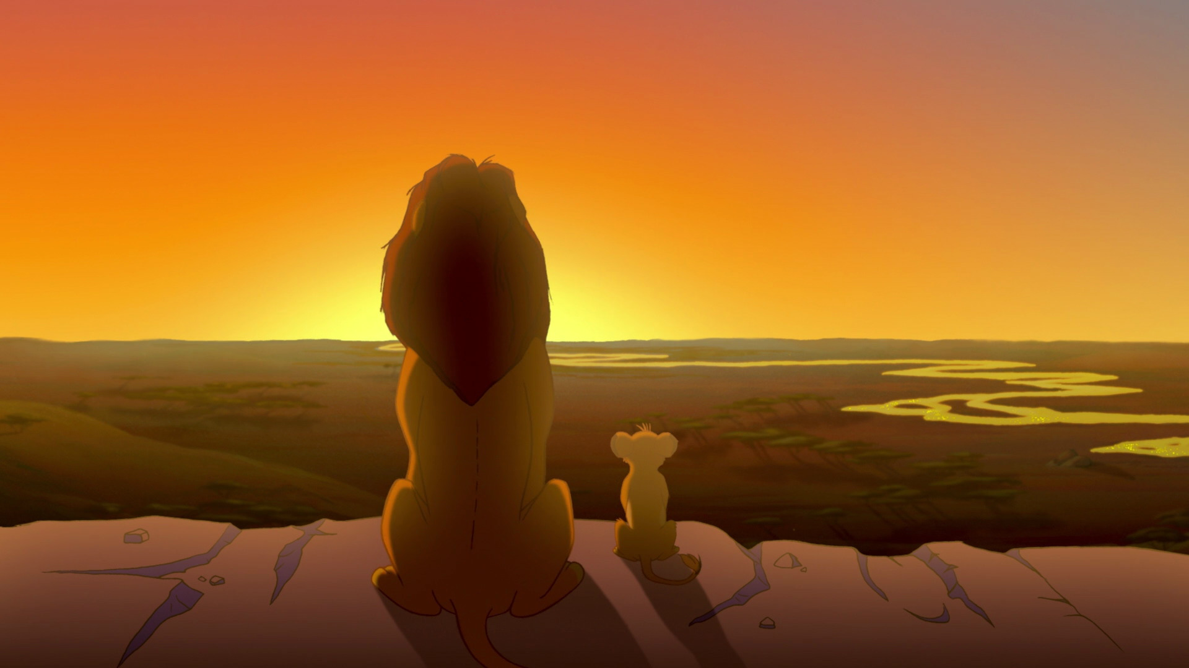
Who Are You Watching?

Slide 12
Matthew 6:19-21
¹⁹ “Do not store up for yourselves treasures on earth, where moths and vermin destroy, and where thieves break in and steal. ²⁰ But store up for yourselves treasures in heaven, where moths and vermin do not destroy, and where thieves do not break in and steal. ²¹ For where your treasure is, there your heart will be also.

Slide 13
Influencing Others for Jesus

Slide 14
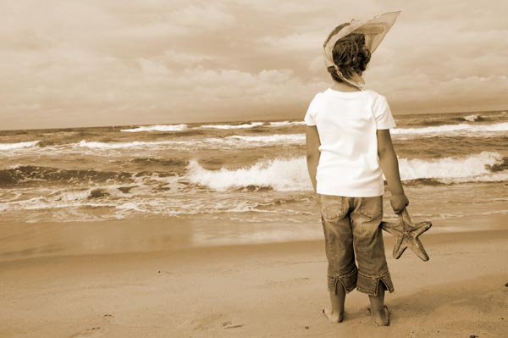

Slide 15
Become More Like Jesus

Slide 16
Luke 6:39-40 ESV
³⁹ He also told them a parable: “Can a blind man lead a blind man? Will they not both fall into a pit? ⁴⁰ A disciple is not above his teacher, but everyone when he is fully trained will be like his teacher.

Slide 17
1 Thessalonians 1:4-8
⁴ For we know, brothers and sisters loved by God, that he has chosen you, ⁵ because our gospel came to you not simply with words but also with power, with the Holy Spirit and deep conviction. You know how we lived among you for your sake.

Slide 18
⁶ You became imitators of us and of the Lord, for you welcomed the message in the midst of severe suffering with the joy given by the Holy Spirit. ⁷ And so you became a model to all the believers in Macedonia and Achaia. ⁸ The Lord’s message rang out from you not only in Macedonia and Achaia—your faith in God has become known everywhere.

Slide 19
Video

Slide 21
Are we willing to give up what we cannot keep to gain what we cannot lose so that others will come to know Jesus?

