Slide 1
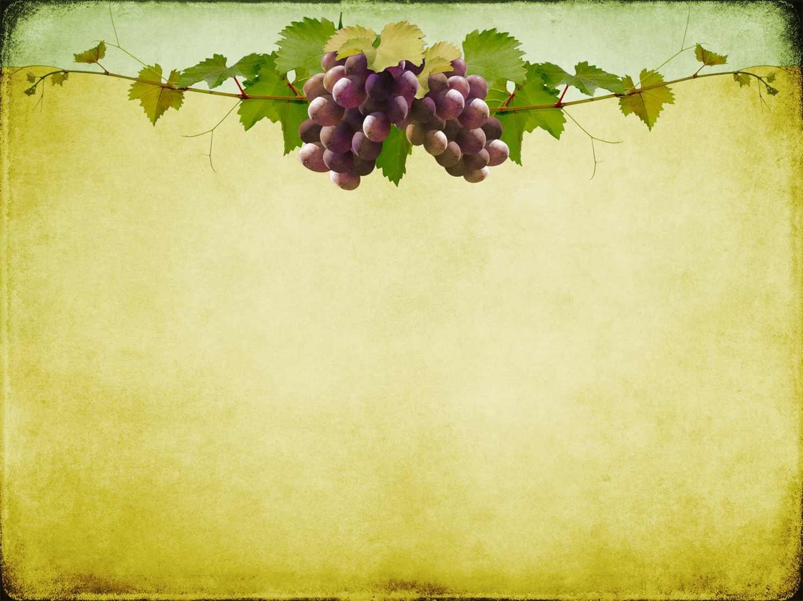

Slide 4
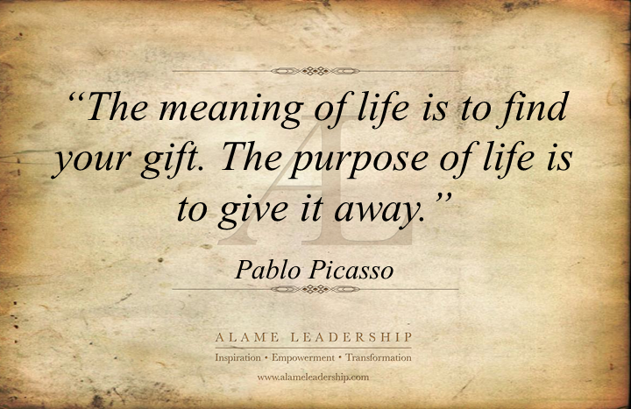

Slide 6
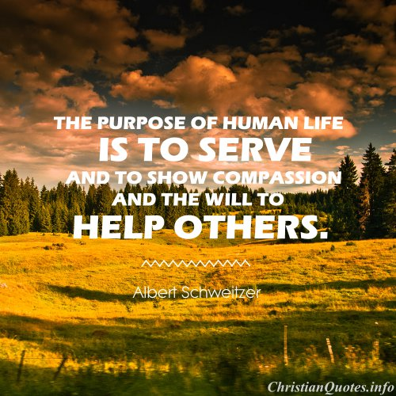

Slide 7
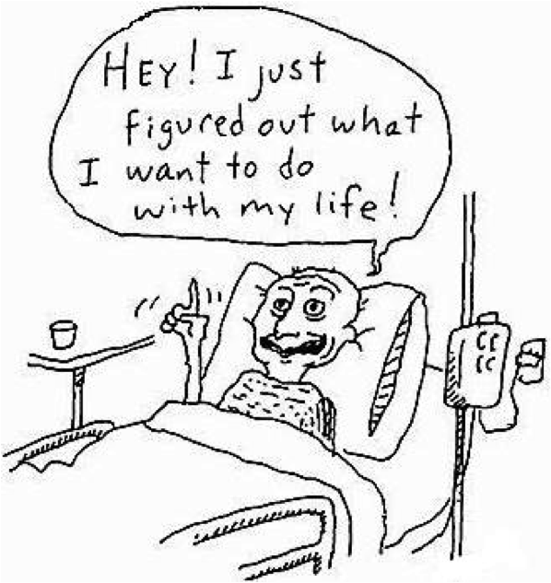

Slide 9
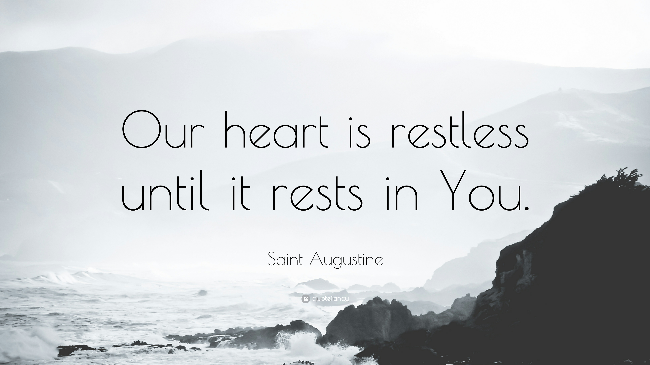

Slide 10
John 15:1-8
¹ “I am the true vine, and my Father is the vinedresser.
² Every branch in me that does not bear fruit he takes away, and every branch that does bear fruit he prunes, that it may bear more fruit.

Slide 11
John 15:1-8
³ Already you are clean because of the word that I have spoken to you.
⁴ Abide in me, and I in you. As the branch cannot bear fruit by itself, unless it abides in the vine, neither can you, unless you abide in me.

Slide 12
John 15:1-8
⁵ I am the vine; you are the branches. Whoever abides in me and I in him, he it is that bears much fruit, for apart from me you can do nothing.
⁶ If anyone does not abide in me he is thrown away like a branch and withers; and the branches are gathered, thrown into the fire, and burned.

Slide 13
John 15:1-8
7 If you abide in me, and my words abide in you, ask whatever you wish, and it will be done for you.
8 By this my Father is glorified, that you bear much fruit and so prove to be my disciples.

Slide 14
Cultivate the Presence of God

Slide 15
Abide: Meno
To stay, continue, dwell, remain or stand

Slide 16
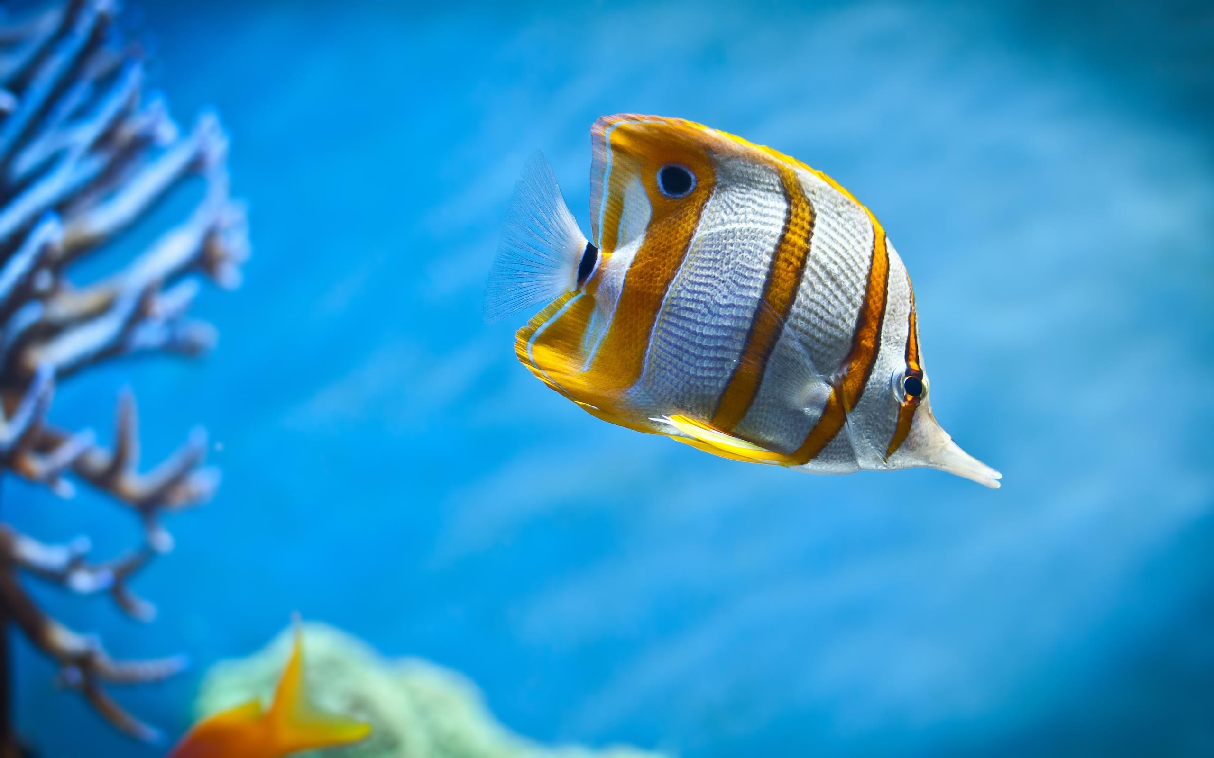

Slide 17
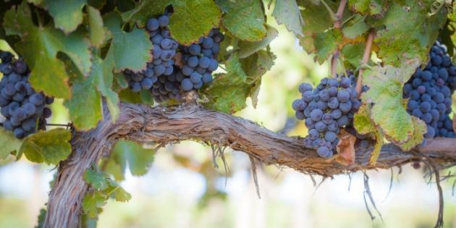

Slide 18
John 15:1-8
¹ “I am the true vine, and my Father is the vinedresser.
² Every branch in me that does not bear fruit he takes away, and every branch that does bear fruit he prunes, that it may bear more fruit.

Slide 19
Pray the Psalms
Take 5 minute retreats
Make Praise a Habit

Slide 20
Abiding requires Pruning

Slide 21
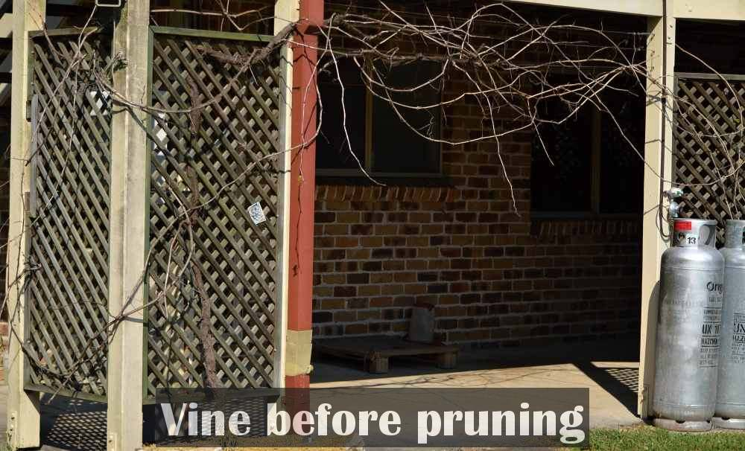

Slide 22
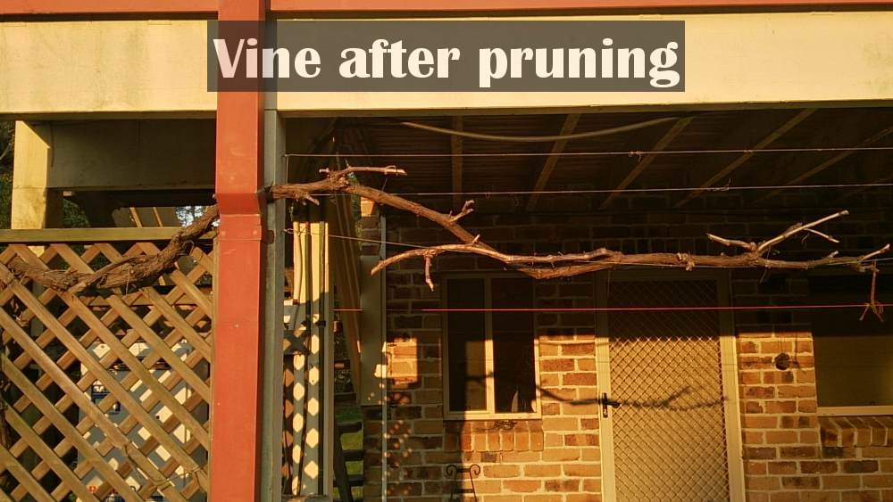

Slide 24
To Produce Fruit You Must Remain In The Vine

